Slide 1

Plant diseases detection based on deep learning and Machine vision
Project Guide :
RAJKUMAR S
Associate Professor (SCOPE)
Presented By:
NIDHI SINGH(22MAI0015)
M.Tech (AI&ML)

Slide 2
Introduction
Deep learning
Problem Statement
Literature review
Gap Analysis
Research objective
Research framework
Dataset Description
Methodology
Implementation Results
Comparative Analysis
Conclusion and Future Scope
References
CONTENT

Slide 3
Introduction
Diseases found in agriculture crops is a major threat that cause production and economic losses as well as reduction in both quality and quantity of agriculture products.
In India 70% of population depend on agriculture and contributes 17% towards the GDP of country.
Farmers experience great difficulties in switching from one disease control policy to another. The naked eye observation of experts is the traditional approach, this method can be time consuming, expensive and inaccurate.
The crop losses can be minimized by applying pesticides or its equivalent to combat the effect of specific pathogens, if diseases are correctly diagnosed and identified early.

Slide 4
3 of 25
Deep Learning
Deep learning is the machine learning technique which perform fast analysis of image data due to that whole system can run in online and real time conditions.
Convolutional Neural Network algorithm comprises of many layers like convolutional layers, pooling layers and fully connected layers.
It has the ability to identify important aspects without human inspection. It prefers less pre-processed data while comparing with other algorithms. It’s more accurate and effective than other algorithms.
This algorithm minimizes the computation time and process, enhance the performance and also reduce irrelevant variables and redundancies in order to obtain robustness.

Slide 5
Agriculture is an integral part of the Indian economy.
Farmers' economic growth is determined by the quality of the goods they make, which is dependent on plant growth and yield.
As a result, in the field of agriculture, disease identification in plants is important. Plants are highly susceptible to diseases that inhibit plant development, which has an effect on the farmer's ecology.
The use of an automated disease detection technique is advantageous in detecting a plant disease at an early stage. Plant diseases manifest themselves in various parts of the plant, such as the leaves.
It takes a long time to manually diagnose plant disease using leaf photographs. As a result, computational methods must be developed to automate the process of disease detection and classification using leaf images.
Problem statement

Slide 6

Literature Review

Slide 7
Literature Review
S.No. | Paper Title | Method | Description | Conclusion/Drawback | No. of images
1. | Plant Disease Detection Using Image Processing and Machine Learning | It uses statistical machine learning and image processing algorithm. Data preprocessing and feature extraction | This paper proposes a smart and efficient technique for detection of crop disease which uses computer vision and machine learning techniques | The proposed model is very simple and could not perform well with different kind of plant. The average accuracy of the model is also less. | The dataset consists of 87000 RGB images of healthy and unhealthy plant leaves having 38 classes out of which They have selected only 25 classes for experimentation of their algorithm
2. | Plant Disease Identification Based on Deep Learning Algorithm in Smart Farming | Deep Learning Region proposal network (RPN) Chan–Vese (CV) algorithm | This paper shows that the plant disease recognition model based on deep learning has the characteristics of unsupervised, high accuracy, good universality, and high training efficiency. | there are still some problems to be pointed out. For example, the Chan–Vese algorithm needs repetitive iterative calculation and runs for a long time, which is not conducive to the fast identification results of this method. | The paper employs Crawler technology and obtains 1000 leaf photos from the Plant Photo Bank of China (PPBC), including the leaves of various plants at each growth stage.

Slide 8
Literature Review
S.No. | Paper Title | Method | Description | Conclusion/Drawback | No. of images
3. | Deep Learning-Based Leaf Disease Detection in Crops Using Images for Agricultural Applications | They focused on fine tuning the hyperparameters of popular pre-trained models, such as DenseNet-121, ResNet-50, VGG-16 | In this paper, we utilized convolutional neural network (CNN)-based pre-trained models for efficient plant disease identification | The experiments proved that DenseNet-121 achieved 99.81% higher classification accuracy, which was superior to state-of-the-art models. | The experiments were carried out using the popular PlantVillage dataset, which has 54,305 image samples of different plant disease species in 38 classes.
4. | Crop plant disease detection using deep learning | convolutional neural network (CNN) ResNet50 MobileNet | It used image based prediction technique to develop three models for predicting diseases in different plant species. | This model more focused on strawberry leaves rather than whole dataset. | The dataset consist of 1700 images collected from Kaggle and real-life field visits.

Slide 9
Gap Analysis
The gap analysis for plant disease detection reveals several key areas where further research and development are needed.
Generalization and Robustness
Segmentation Techniques
Real-time Data Collection
Diverse Training Data
Attention Mechanisms and Model Complexity
Integration of Multiple Diagnostic Methods
Transparency and Expanded Features

Slide 10
Research Objective
The objective of our research is to present the integrated aspects of machine vision and deep learning techniques in plant diseases detection
Develop robust Deep learning models for adaptable and generalized plant disease detection.
To develop and implement effective methods, techniques, and technologies for the early and accurate identification and diagnosis of diseases in plant leaves.
One of the helpful measures in plant disease detection methods can be done with the help of image processing and neural network. Neural network and deep learning in some recent research have proved its worth in doing such classification tasks efficiently.

Slide 11
Specify the need of Plant diseases detection.
Collection of dataset.
Research Framework
Design algorithm for selected model.
Train and optimize deep learning models to improve the accuracy of disease detection
Analysis of confusion matrix and accuracy of architecture
Process with best result is selected for disease detection.

Slide 12
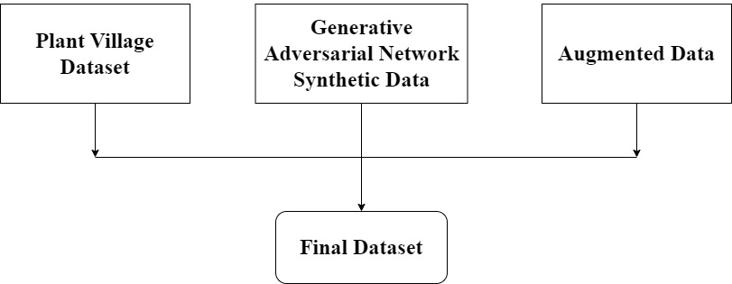
Dataset Description
The study utilizes the PlantVillage dataset, comprising 29,928 photos carefully selected to enhance plant disease identification through computer vision and deep learning.
Employing data augmentation methods and a Generative Adversarial Network (GAN), an additional 9,973 augmented photos are introduced to ensure a diverse and comprehensive dataset spanning 20 plant health and disease categories across various crops.

Slide 13
Class No. | Class Names | Number of Images
0 | Blueberry___healthy | 2002
1 | Apple___Cedar_apple_rust | 777
2 | Apple___healthy | 2146
3 | Cherry_(including_sour)___healthy | 1363
4 | Cherry_(including_sour)___Powdery_mildew | 1564
5 | Corn_(maize)___Cercospora_leaf_spot Gray_leaf_spot | 1015
6 | Corn_(maize)___Common_rust_ | 1707
7 | Corn_(maize)___healthy | 1662
8 | Corn_(maize)___Northern_Leaf_Blight | 1485
9 | Grape___Black_rot | 1681
10 | Grape___Esca_(Black_Measles) | 1884
11 | Grape___healthy | 916
12 | Grape___Leaf_blight_(Isariopsis_Leaf_Spot) | 1577
13 | Pepper,_bell___Bacterial_spot | 1487
14 | Pepper,_bell___healthy | 1976
15 | Potato___Early_blight | 1476
16 | Potato___healthy | 552
17 | Potato___Late_blight | 1496
18 | Strawberry___healthy | 956
19 | Strawberry___Leaf_scorch | 1609

Slide 14
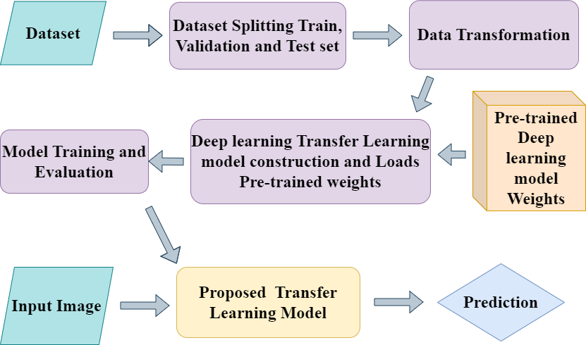
Methodology

Slide 15
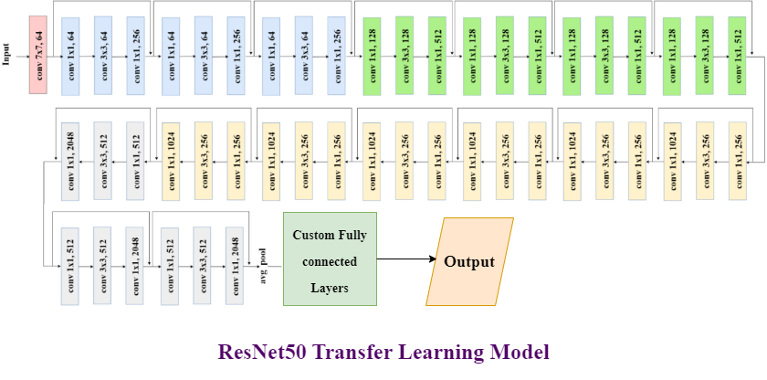
Model Architecture

Slide 16
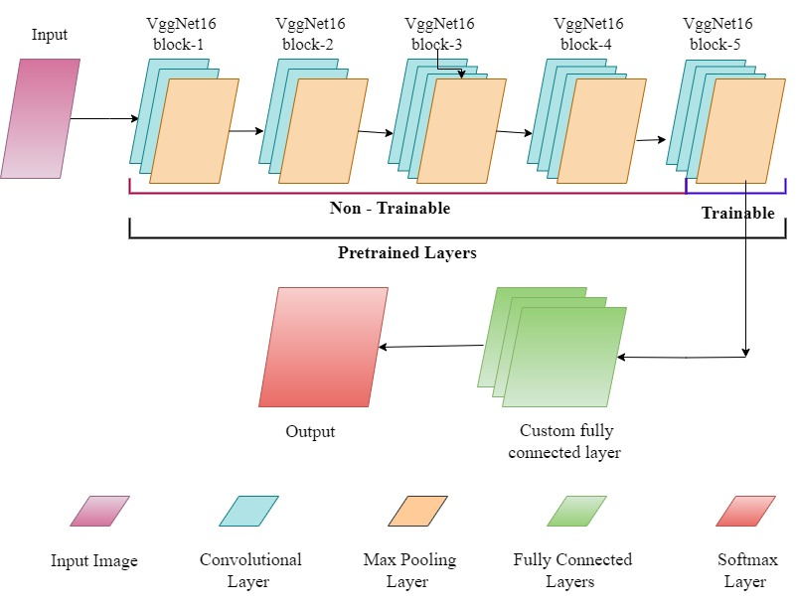
VggNet16 TL model

Slide 17
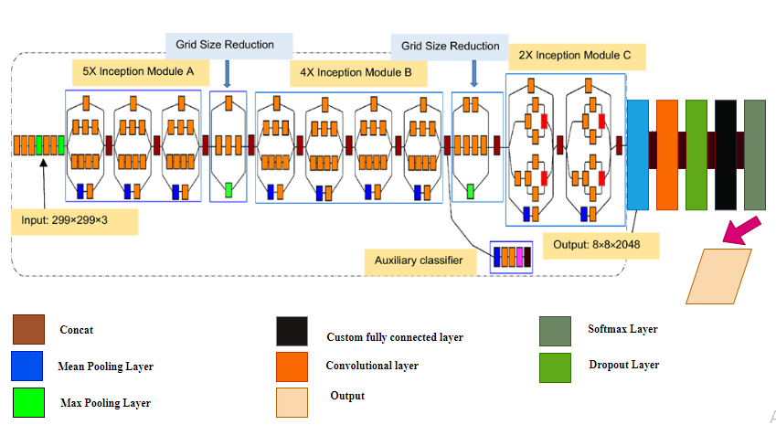
InceptionNet V3 TL Model

Slide 18
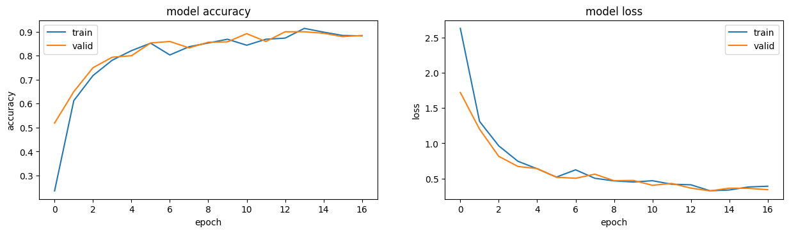
Implementation Results
ResNet50 TL MODEL
Parameter name | Accuracy(%) | Loss
Training | 88.28 | 0.3898
Validation | 88.44 | 0.3409
Test | 83.23 | --------

Slide 19
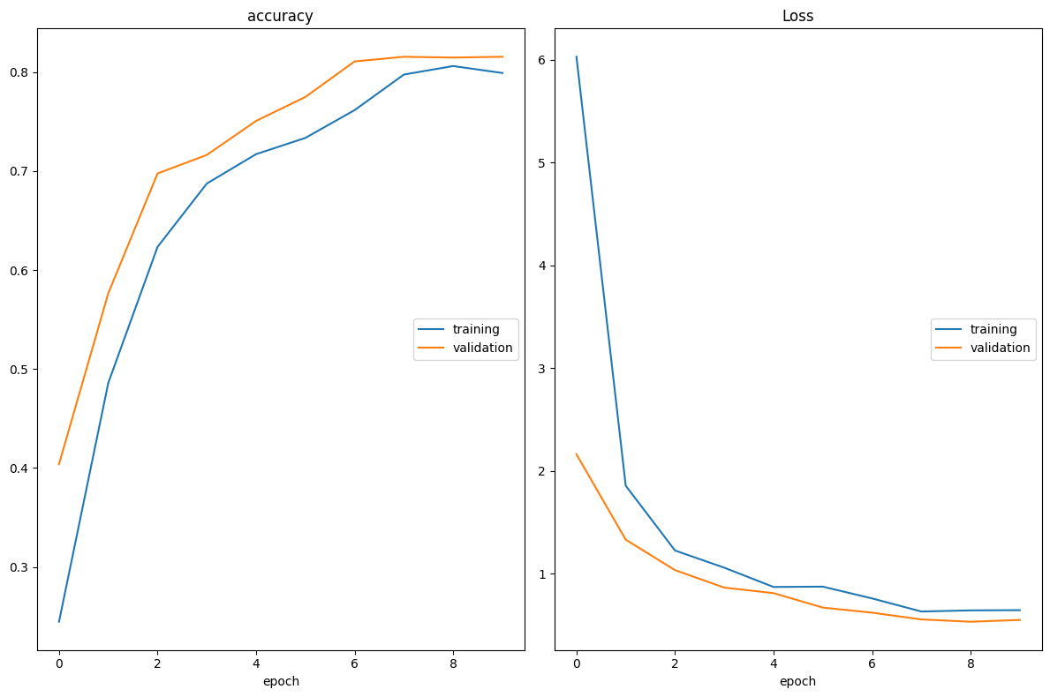
VggNet16 TL model
Parameter name | Accuracy | Loss
Training | 79.92 | 64.67
Validation | 81.56 | 55.14
Test | 79.27 | -

Slide 20
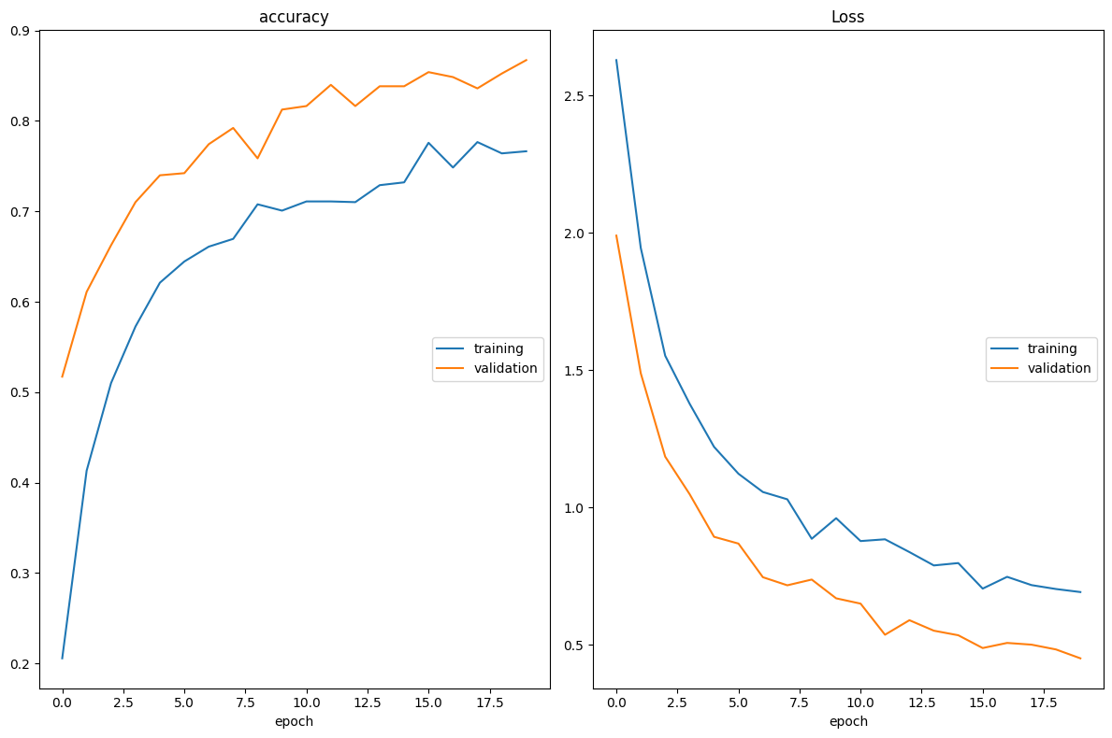
InceptionNet V3 TL model
Parameter name | Accuracy | Loss
Training | 76.64 | 0.6915
Validation | 86.72 | 0.4501
Test | 74.82 | ---------

Slide 21
Comparative Analysis
Model | Precision | Recall | F1-Score | Accuracy
ResNet50 TL | 86.56% | 83.23% | 83.06% | 83%
VggNet16 TL | 77.77% | 72.04% | 71.30% | 72%
InceptionNet V3 TL | 80.26% | 74.82% | 73.32% | 75%
VggNet16 TL with Fine tune | 81.93% | 79.27% | 78.81% | 79%
InceptionNet V3 TL With fine tune | 80.81% | 76.43% | 73.32% | 76%

Slide 22
Conclusion and Future Scope
ResNet50 excels in plant disease detection, highlighting the effectiveness of its deep residual learning architecture in transfer learning.
VGG16 shows improved accuracy through fine-tuning, emphasizing its adaptability in the context of pre-trained models.
InceptionV3 demonstrates competitive performance, both with and without fine-tuning, showcasing its ability to balance computational efficiency and classification accuracy.
Future improvements in image classification could explore self-supervised learning, fine-tuning strategies, and diverse evaluations to enhance model flexibility and generalization across various real-world scenarios.

Slide 23
References
[1] N, Banupriya & chowdry, Rajaneni & Yogeshwari, & V,Varsha,.(2022), ‘PLANT DISEASE DETECTION USING IMAGE PROCESSING AND MACHINE LEARNING ALGORITHM’, 10.37896/jxu14.7/012.
[2] Yan Guo, Jin Zhang, Chengxin Yin, Xiaonan Hu, Yu Zou, Zhipeng Xue, Wei Wang. (2020) "Plant Disease Identification Based on Deep Learning Algorithm in Smart Farming", Discrete Dynamics in Nature and Society, vol. 2020, Article ID 2479172, 11 pages,. https://doi.org/10.1155/2020/2479172.
[3] J., Andrew, Jennifer Eunice, Daniela Elena Popescu, M. Kalpana Chowdary, and Jude Hemanth. (2022)."Deep Learning-Based Leaf Disease Detection in Crops Using Images for Agricultural Applications" Agronomy 12, no. 10: 2395. https://doi.org/10.3390/agronomy12102395.
[4] Mohanty, S. P., Hughes, D. P., & Salathé, M. (2016) “Using Deep Learning for Image-Based Plant Disease Detection”. Frontiers in plant science, 7, 1419. https://doi.org/10.3389/fpls.2016.01419

Slide 24
Thank You

